Slide 1
Treasurer’s Report
Presented by Michael Davis, Treasurer
St. Columba’s Episcopal Church
November 12, 2023

Slide 2
AGENDA
2023 Audit (Church & Nursery School)
2023 Operating Results
2024 Budget
Stewardship Update

Slide 3
2023 Audit Highlights (Church and Nursery School)
St. Columba’s independent auditors gave our financial statements a clean (unqualified) opinion
They found no material weaknesses and no significant deficiencies.
The audit was completed on time.

Slide 4
2023 Audit Highlights (Church and Nursery School) (in $000s)
 | 2022 | 2023
Assets Cash and Investments Contribution receivable, net Property and equipment, net Other Assets Total Assets | $4,152 $2,309 $9,055 $173 _______ $15,690 _______ _______ | $4,916 $2,679 $8,701 $60 _______ $16,356 _______ _______
Liabilities and Net Assets Accounts payable and other Notes payable Total Liabilities | $1,186 $2,127 _______ $3,312 _______ | $1,388 $2,010 _______ $3,428 _______
Net Assets Total liabilities and Net assets | $12,377 _______ $15,690 _______ _______ | $12,928 _______ $16,356 _______ _______
Notes:
The Church and the Nursery School are one legal entity, so our audit is on a consolidated basis.
In 2022, the Nursery School recommenced both its after school and summer programs, which contributed to increased cash and revenue.
Contributions receivable represent pledges that have not yet been collected. The large amounts in 2021 and 2022 are largely due to pledges to fund the renovations of the Nave. Those pledges are paid over five years..
Property increased because of the Nave renovations.
Accounts payable decreased because we had less in outstanding bills for Nave renovations.
Our debt increased because we incurred additional debt to fund the Nave renovations. The costs of the Nave renovations have to be paid before all the pledges for the renovations are paid, but as those pledges are paid, we will pay off the additional debt.

Slide 5
2023 Audit Highlights (Church and Nursery School) (in $000s)
 | 2022 | 2023
Revenue Contributions Tuition and fees, net | $3,256 $2,454 | $4,012* $2,157
Program and event income Investment income, net Other income Total Revenue | $142 (312) 0 _______ $5,539 | $151 $181 6 _______ $6,507
* Includes $872 Leap of Faith strategic fundraising campaign
Notes:
The Church and the Nursery School are one legal entity, so our audit is on a consolidated basis.
In 2022, the Nursery School recommenced both its after school and summer programs, which contributed to increased cash and revenue.
Contributions receivable represent pledges that have not yet been collected. The large amounts in 2021 and 2022 are largely due to pledges to fund the renovations of the Nave. Those pledges are paid over five years..
Property increased because of the Nave renovations.
Accounts payable decreased because we had less in outstanding bills for Nave renovations.
Our debt increased because we incurred additional debt to fund the Nave renovations. The costs of the Nave renovations have to be paid before all the pledges for the renovations are paid, but as those pledges are paid, we will pay off the additional debt.

Slide 6
2023 Audit Highlights (Church and Nursery School) (in $000s)
 | 2022 | 2023
Expenses Program services Church Nursery School Total Program Services | $3,023 $1,944 _______ $4,966 | $3,199 $1,971 _______ $5,170
Management and general Fundraising Total Expenses Net assets released from restriction | $350 $138 _______ $5,455 $2,173* | $628 $48 _______ $5,846 $144
* Includes released from the Nave Renovation Project
Notes:
The Church and the Nursery School are one legal entity, so our audit is on a consolidated basis.
In 2022, the Nursery School recommenced both its after school and summer programs, which contributed to increased cash and revenue.
Contributions receivable represent pledges that have not yet been collected. The large amounts in 2021 and 2022 are largely due to pledges to fund the renovations of the Nave. Those pledges are paid over five years..
Property increased because of the Nave renovations.
Accounts payable decreased because we had less in outstanding bills for Nave renovations.
Our debt increased because we incurred additional debt to fund the Nave renovations. The costs of the Nave renovations have to be paid before all the pledges for the renovations are paid, but as those pledges are paid, we will pay off the additional debt.

Slide 7
2023 Audit Highlights (Church and Nursery School) (in $000s)
Total Change in net assets | $660,797
Change in net assets (Church) | $360,097
Mainly because of Leap of Faith strategic fundraising
Change in net assets (Nursery School) | $300,700
Mainly because expenses were under budget

Slide 8
2023 Audit Highlights (Church and Nursery School)
Debt to Equity Ratio
2023 | 2022 | 2021 | 2020 | 2019
26.5% | 26.8% | 20.0% | 17.0% | 20.8%
Liquid Unrestricted Net Assets (LUNA)
 | 2023 | 2022 | 2021 | 2020 | 2019
LUNA | $5.3M | $4.5M | $1.9M | $3.0M | $3.0M
Months of LUNA | 10.78 | 9.79 | 4.18 | 6.29 | 6.69

Slide 9
2023 Results (Church only)
Change in net assets – all activities – surplus | $360,097
Mainly because of Leap of Faith strategic fundraising
Change in net assets – operations – breakeven | ($9,197)
(Revenue and expenses under budget)
Total operating revenue | $3,271,807
Total pledge revenue | $2,578,966
Difference | _______ $692,841
Pledges provided only 79% of operating revenue

Slide 10
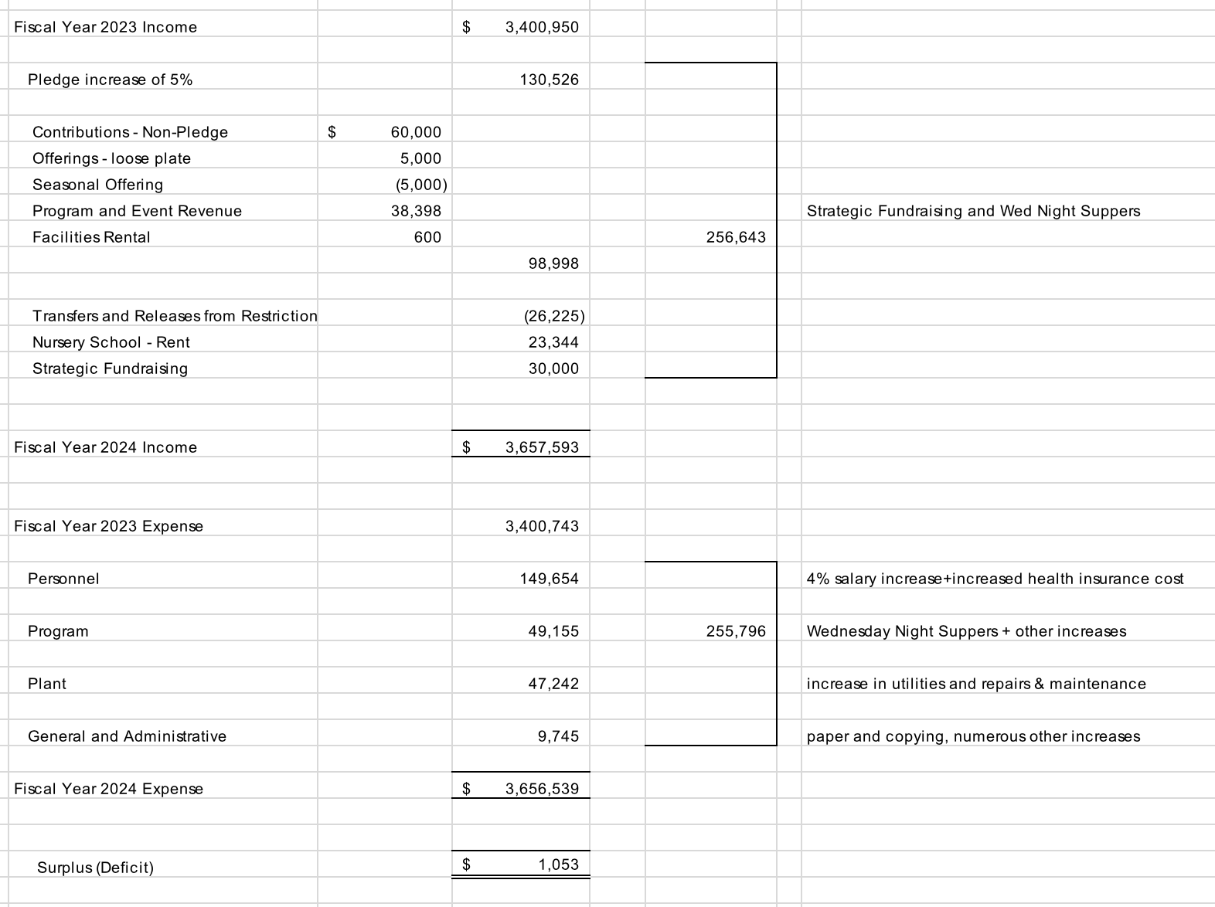
Reconciliation of 2023 to 2024 Budget
(Church only)

Slide 11
Stewardship Pledge Trends
570
Pledges
639
Pledges
610
Pledges
596
Pledges
570
Pledges
575
Pledges

Slide 12
Thank You!
If you have pledged, thank you!
If you haven’t pledged, please do!
If you can increase your pledge, please do!
Thank you for your support!

